Slide 1
Harsha Bodapati Jiahui Chen
Parth Shorey
Airport Database Management System

Slide 2
Project Goal
The goal of this DBMS is to give different types of users great control of operations based on their access rights to retrieve and manipulate data. The airport database management system provides robust and efficient operational planning. Airport Management’s scheduling and ‘what if’ scenario simulation ensures support for every operational flight planning and management processes.

Slide 3
Outline of the Presentation
•Purpose/Goal
•Description : Pictures are essential
An ER Diagram and an Interface snapshot indicating users interaction with the db.
•Project Stumbling Blocks
Data collection
Conceptual Diagram
Integrity constraints
SQL Implementation
Sample of findings
•Future Extensions/Work
•References/Resources used (libraries, languages, web resources)
•Acknowledgement

Slide 4
Description
There are three types of users.
1. Passengers can log in to the system to check flight information and easily manage their flights.
2. For employees of the airport, there were two views. One for captains and flight attendants and another for staff members, as they can change aspects of the database.
3. Administrators have highest access right to the DBMS. An administrator can modify flight information; assign pilots and flight attendants to corresponding flights; and also has the right to change flight routes when emergency occurs.

Slide 5
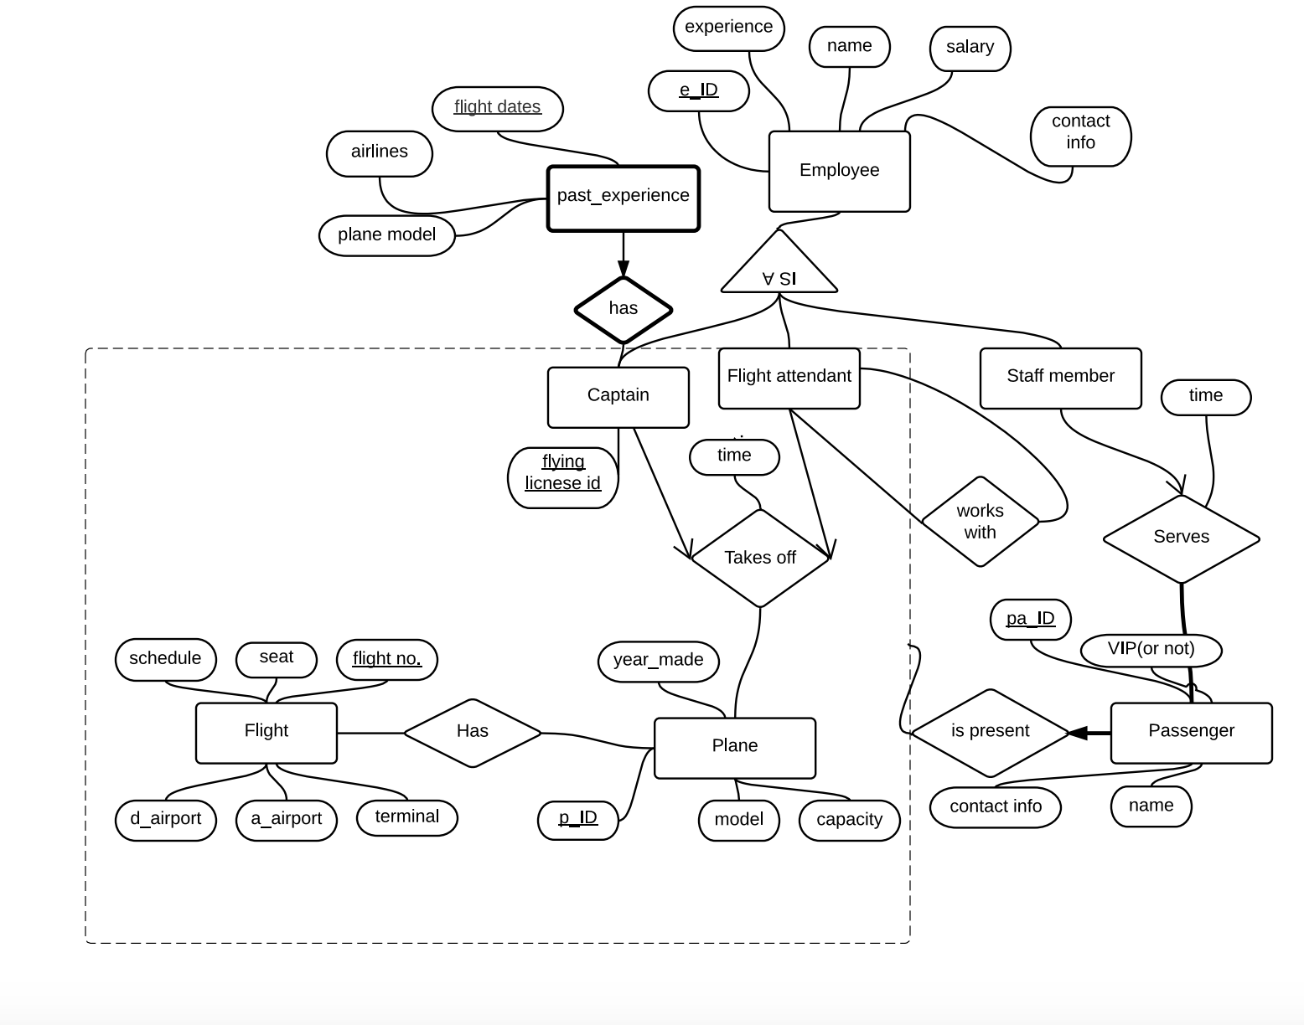
picture of ER diagram

Slide 6
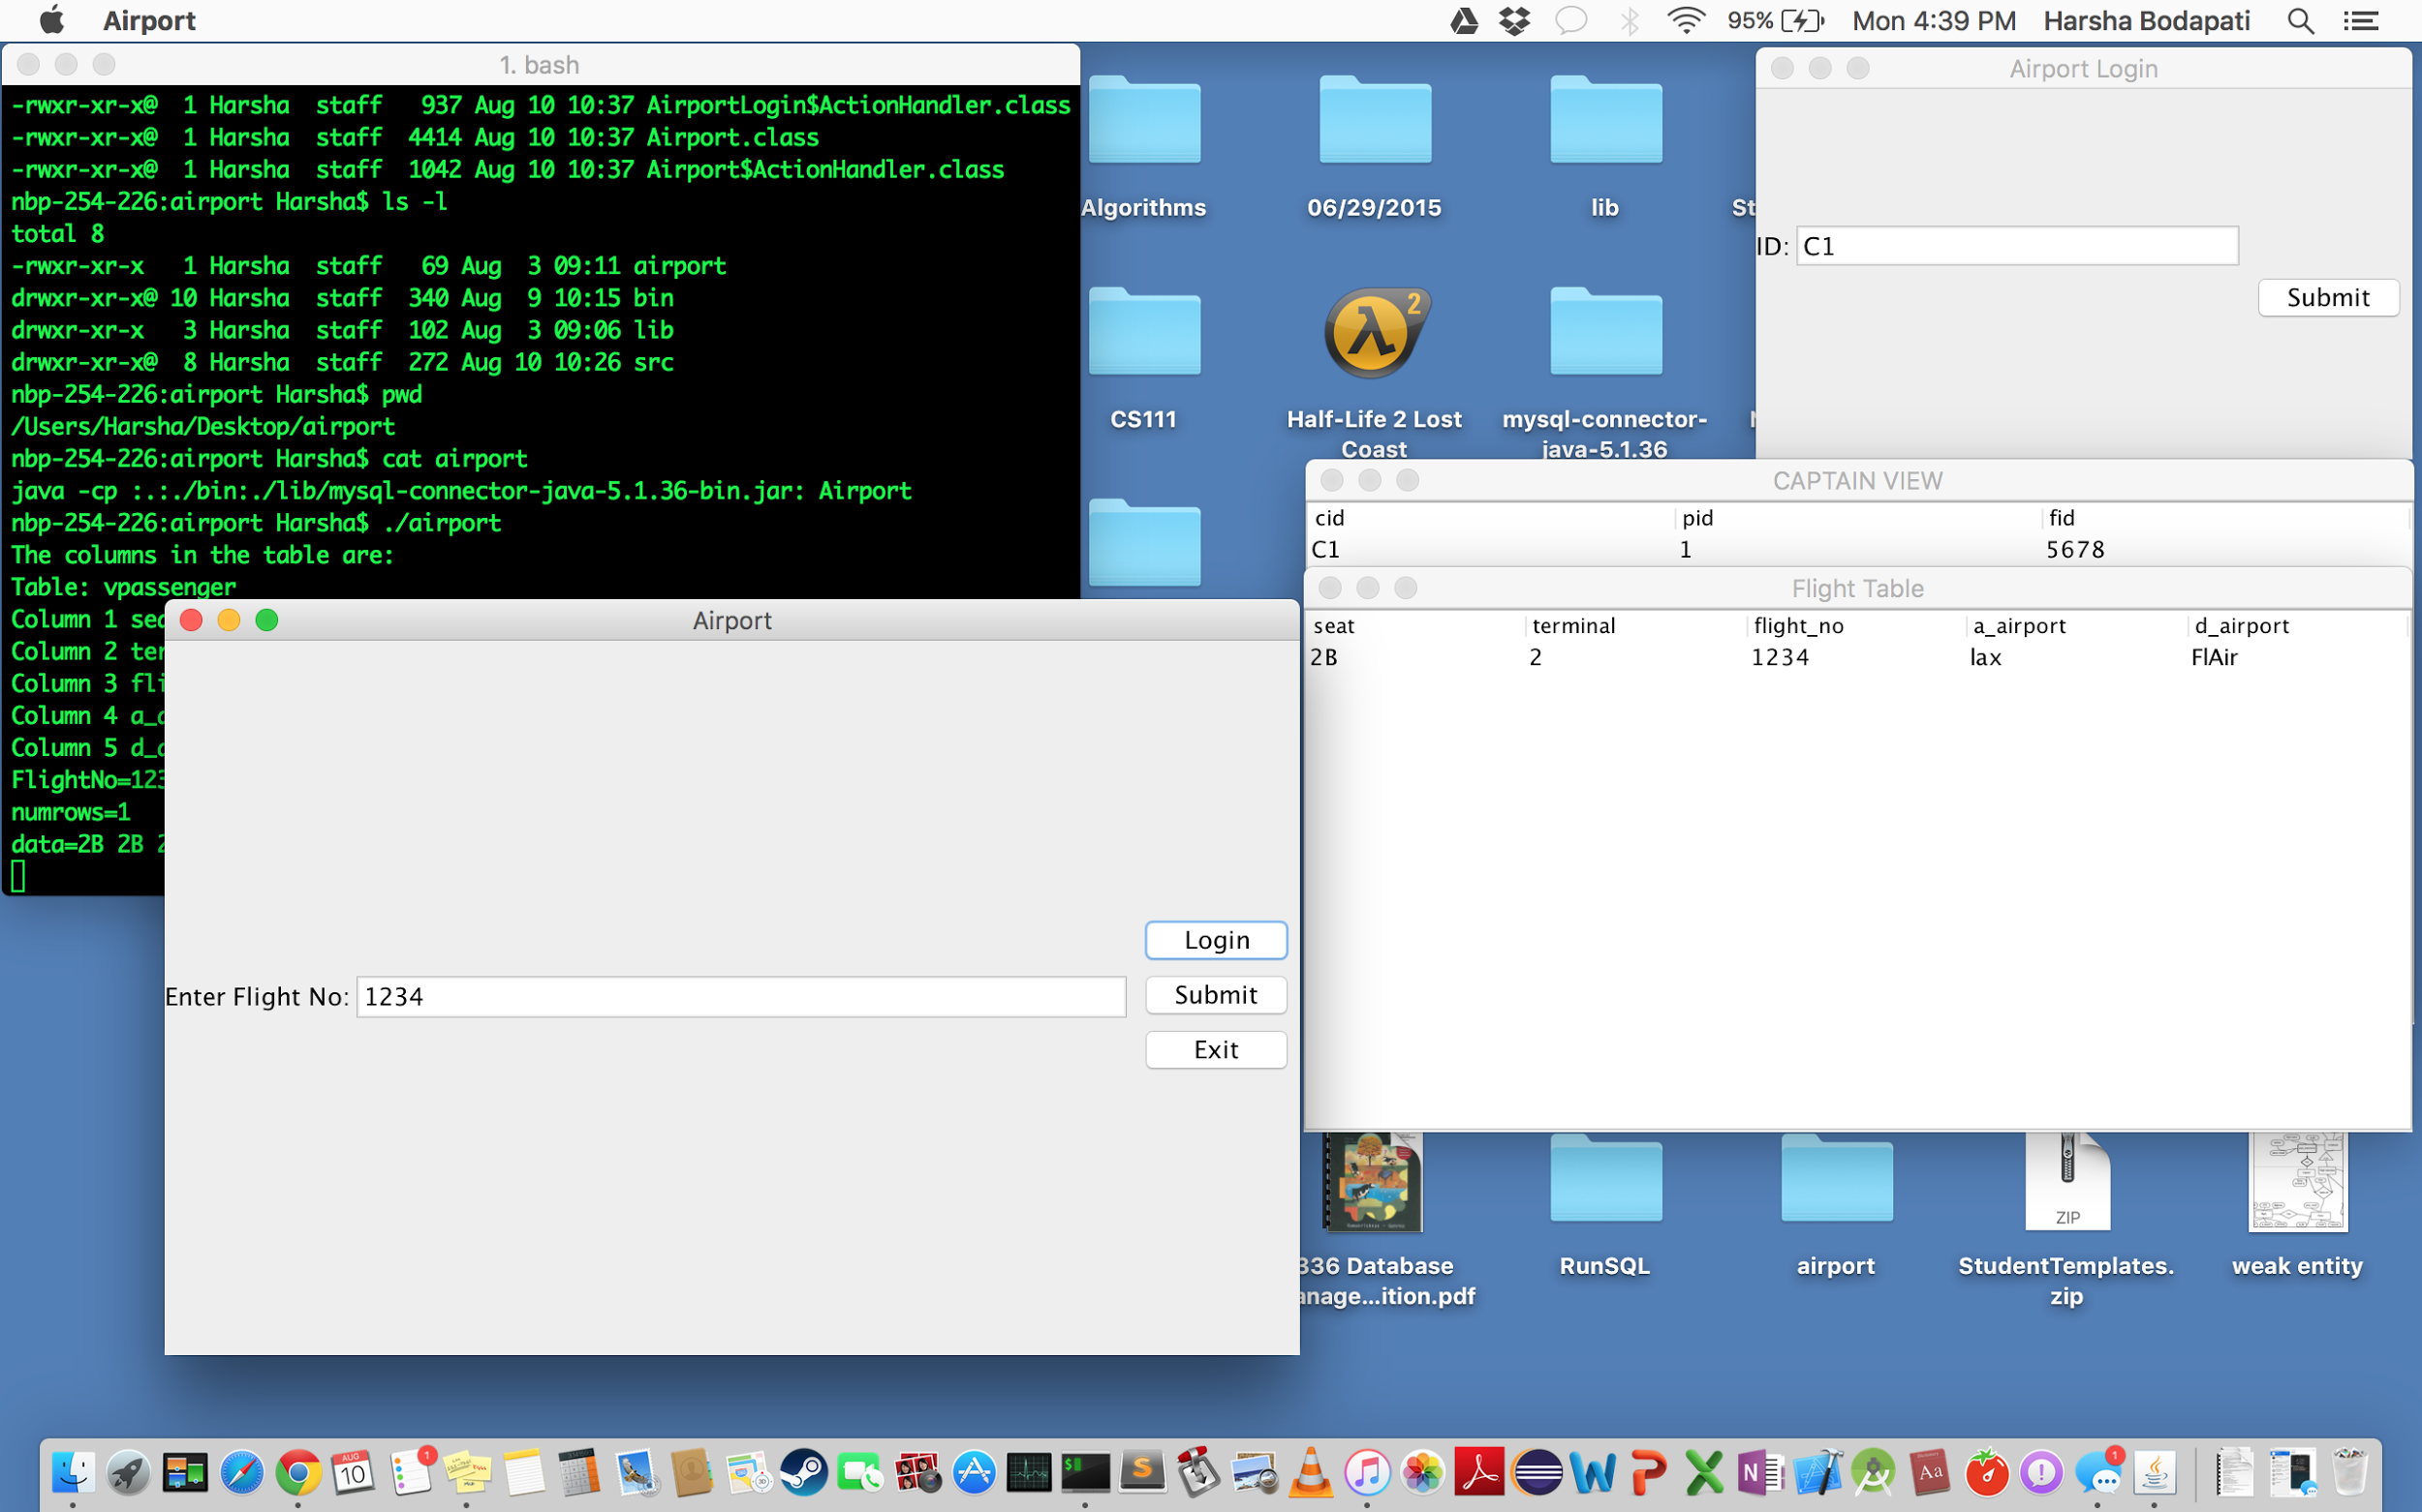
Picture of Interface/diagram

Slide 7
Project Stumbling Blocks
- The first stumbling block we had throughout the project was having to switch topics towards the beginning and redoing a lot of work.
- Stage 2 and 3 went fine, but there were a lot of aspects/explanations that we had to keep changing in order to have the ER diagram make sense.
- For stage 4, initially we were doing all the work on the ilabs and connecting to the database with mysql-connector-java-5.1.36-bin.jar was just taking too much time so we redid the database on own computer and it managed to work with the root password. After that, it went smoothly.

Slide 8
Data collection, Conceptual Diagram, Integrity constraints
The data used pertained to an airport environment.
The dummy data allowed us to experiment with what should be accessible and what should be hidden, in terms of creating the views.
Views such as passenger and flight attendent where given limited access to data. This is because in a real life situation, it could be a security risk.
The integrity constraints were mostly related to admin view (most powerful). The ability to add or remove an instance from a heavily connected entity, meant that there had to be some kind of foreign key constraint.

Slide 9
Sample of findings
-Our RDBMS is optimal in any environment that deals with transportation.
-Our RDBMS can be changed to different transportation types, such as train or buses.
- This is because the security levels between users would be the same.
-Passengers would only be allowed to access data to read information
-Minor employees would have access to what pertained to their route schedule.
-Higher level employees would only have access to change schedules. (Maybe deal with ticketing for passengers.)
-Admin would have full access.
-Best for any organization that wants to give limited access to employees in terms of changing data in the database, and wants to keep sensitive transportation tightly controlled.

Slide 10
Future Extensions
•The project could be expanded by continuing to work on the details of the dbms and interface.
•We could add more data views to improve the usefulness of the database.
•We would eventually like for our project to become where users can interact differently by using it for other more complex aspects in transportation, in order to achieve better and broader usage goals like for busses and trains...etc.

Slide 11
Acknowledgements
•We would like to thank the Riham, Tugba, and Professor Abello for their help and support.

Slide 12
References and Resources used (libraries, languages, web resources)
References- https://dev.mysql.com/doc/
Resources- mysql, java swing, jdbc connector..

